Slide 1
Special Effects Presentation Particle Systems: Smoke
Team LORT
March 4 2015

Slide 2
Task Allocation
 | Task
Sam | Research PArray
Gary | Research Super Spray
Justin | Research forces affecting particle systems (eg. wind)
Sasha | Research Particle Flow (PFlow)
All | Create presentation

Slide 3
Question
Is one method for generating smoke special effects “better” than the others?
Objects to consider:
Super Spray
PF Source (PFlow)
P Array (PBomb)

Slide 4
Answer
That depends on what your requirements are!
Less time to learn:
Super Spray
Customizability:
PFlow
Explosion effects:
PBomb

Slide 5
PFlow: Introduction
PFlow, also known as Particle Flow. Use Particle Flow Source (PF Source) object.
Pros
Lots of customizable features
Cons
Many features makes it more complicated to learn

Slide 6
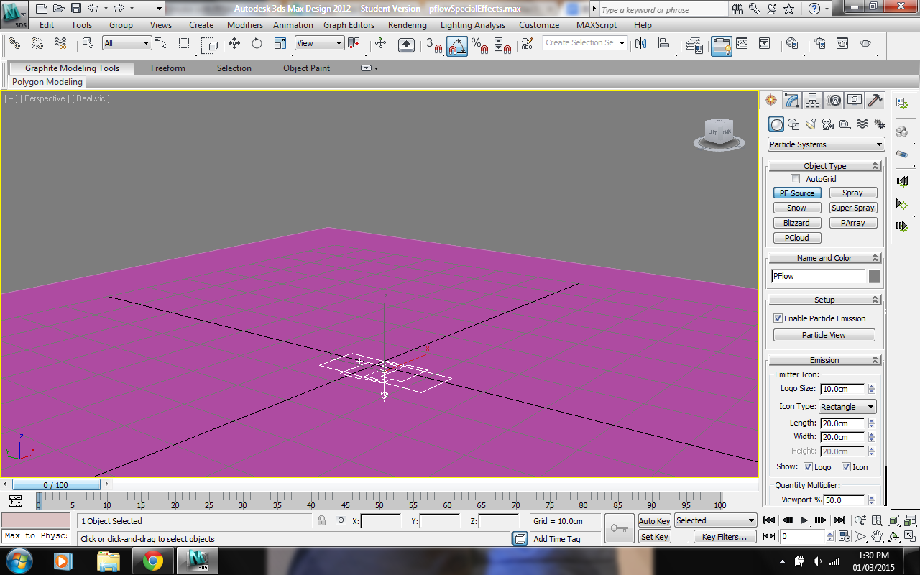
PFlow: Create PF Source Object

Slide 7
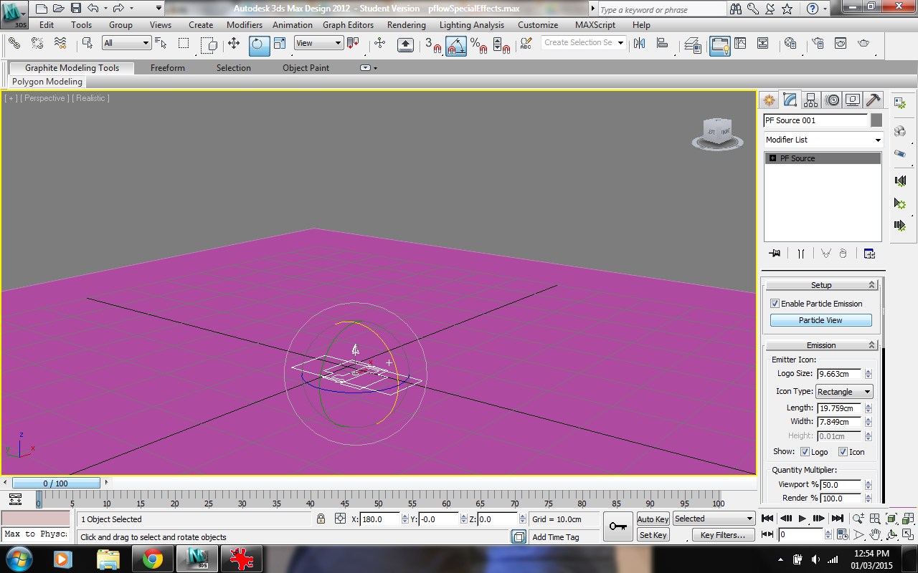
PFlow: Open Particle View

Slide 8
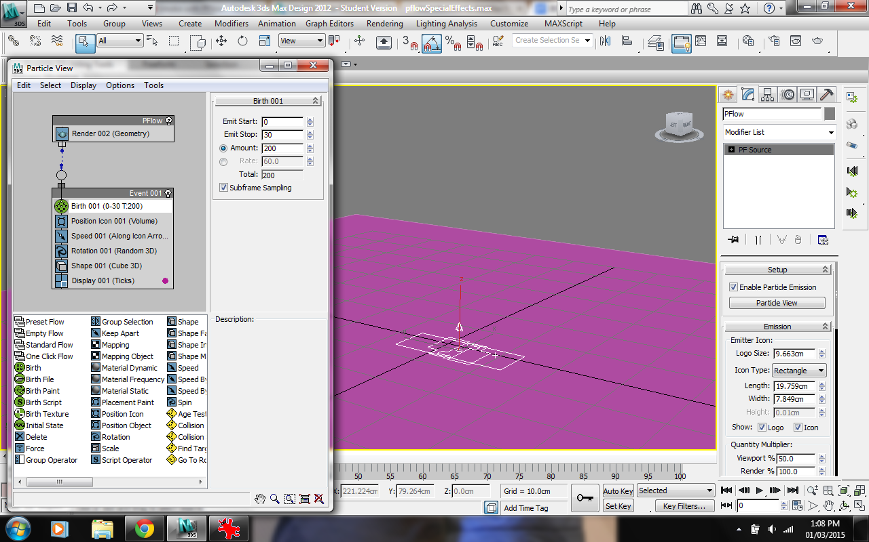
PFlow: Particle View

Slide 9
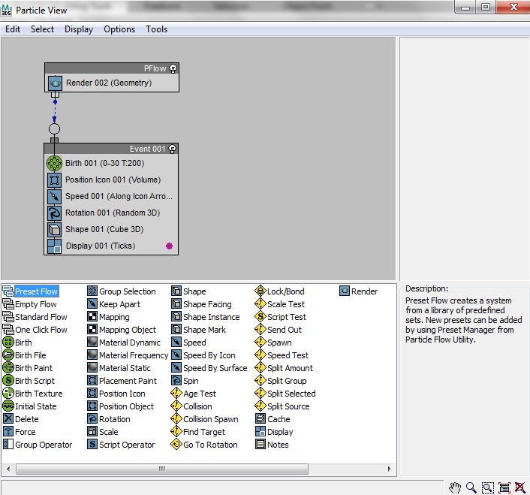
PFlow: Other Events
Notes:
Can drag the other options to the event panel to add more features
Description of each feature is available in bottom right of the window

Slide 10
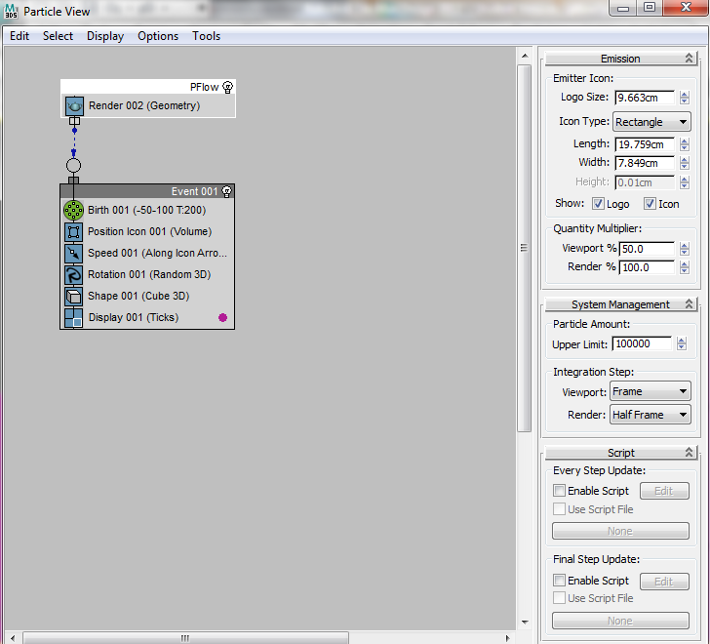
Pflow: Sidebar
Notes:
Emission: Options for the emitter object (size, emitter look, particle look in viewport)
System Management:

Slide 11
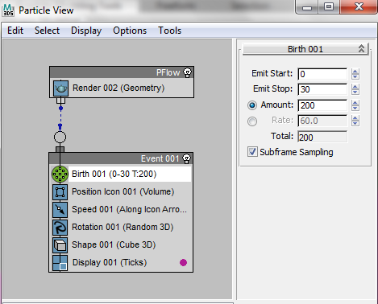
PFlow: Birth
Notes:
Emit start/stop: Frame # for start and end of flow
Amount: Number of particles

Slide 12
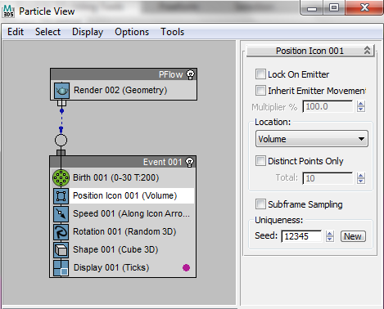
PFlow: Position Icon

Slide 13
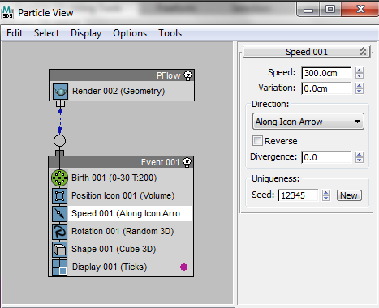
PFlow: Speed
Notes:
Allows the changing of the speed of the particles
Direction changes the direction of the flow
Divergence defines how wide the spread is

Slide 14
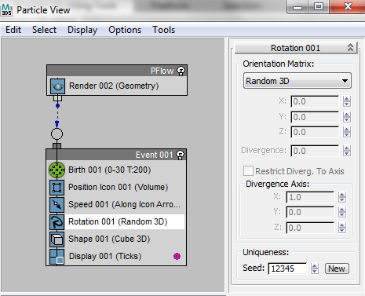
PFlow: Rotation
Notes:
Can change the axis for the flow and spread

Slide 15
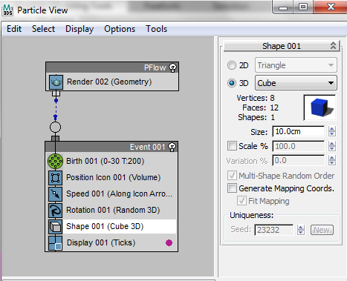
PFlow: Shape
Notes:
Allows each particles shapes to be changed

Slide 16
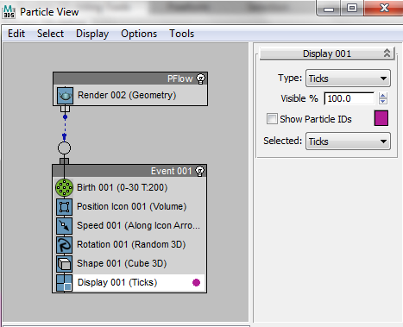
PFlow: Display
Notes:
What is displaye

Slide 17
PFlow: Final Product
[VIDEO]

Slide 18
Super Spray: Introduction
Intro paragraph
Pros
Cons

Slide 19
Super Spray vs. Spray
Super Spray
More features
Harder to learn
More powerful
Spray
Less features
Easier to learn
Lighter weight

Slide 20
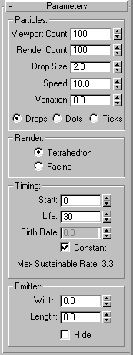
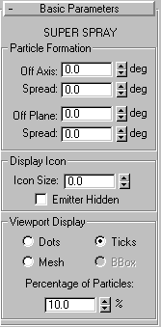
Spray Super Spray

Slide 21
Explosion

Slide 22
Environmental Forces

Slide 23
References
http://www.mrbluesummers.com/738/3d-tutorials/introduction-to-3dsmax-particles
http://makeitcg.com/3ds-max-smoke-effect/1786/
https://www.youtube.com/watch?v=dx4Tjj30kjk
http://knowledge.autodesk.com/
http://3dmax-tutorials.com/Super_Spray.html
http://3dmax-tutorials.com/Spray.html
https://www.youtube.com/watch?v=tYLQ3snrV_8

